Slide 1
ASSESSING PRODUCTIVE SKILLS AT B2. UPDATED FIRST WRITING AND SPEAKING

Slide 2
Assessment is the process of evaluating
(rather than an event!)

Slide 3
Summative,
Learning Oriented Assessment (formative)
Summative: Assessment of learning
LOA seeks to emphasise that a fundamental purpose of assessment should be to promote learning.
LOA mirrors formative assessment and assessment for learning processes.

Slide 4
WRITING

Slide 5
Writing at B2: Can Do statements
I can write clear, ______ text on a wide range of subjects related to my _______.
I can write an essay or report, passing on information or giving _______ in support of or against a particular point of view. I can write letters highlighting the ________ significance of events and experiences.
detailed
interests
reasons
personal

Slide 6
Overview of the Writing paper
Overall timing: 1 hour 20 minutes
Two parts:
Part 1: compulsory essay question
Part 2: one task from a choice of four questions (an article, a review, an essay, a letter, a story)
Each answer should be between 140 and 190 words
Each part has equal marks

Slide 7
Assessment criteria
Content
_________________________________
Communicative achievement
Organisation
Language

Slide 8
cognitive
MESSAGE
linguistic sociolinguistic

Slide 9
The construct of writing tasks
Write a letter to your friend about x and y asking z.
A. message B. cognitive C. linguistic D. sociolinguistic

Slide 10
The construct of writing tasks
Write
Write about x
Write a letter to your friend about x
Write a letter to your friend about x and y asking z
linguistic
message
sociolinguistic
cognitive

Slide 11
Assessment criteria
Content
Communicative Achievement
Organisation
Language
How well the candidate has fulfilled the task.
How appropriate the writing is for the task and whether the candidate has used the appropriate register.
The way the candidate puts together the piece of writing; is it logical and ordered? Are the ideas linked together well?
Focuses on vocabulary and grammar, including range and how accurate it is.

Slide 13
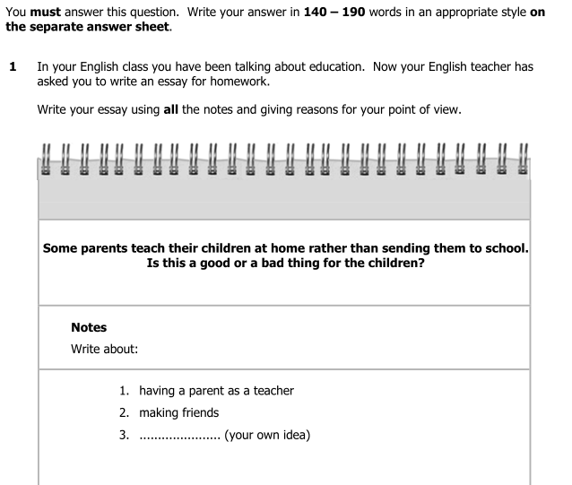
Notes:
As you can see this question now has a more academic focus which will help candidates who want to use English for future studies. This obviously means that you will have to prepare your students for this part of the paper in a different way. They will need to practise writing essays and you will want to focus on structure – how to plan an answer to this type of question, the kind of language they will need to discuss a subject like this and how to make their essay cohesive. You’ll notice that the word count has increased, and is now 140 to 190 words.

Slide 14
Writing Part 1
What is the title of the essay?
Do candidates have to agree with the statement
in the essay title?
Who is the essay for? What register should it
be in?
How many content points do candidates need
to include?
Are all the content points given in the task?
Do candidates need to give reasons for their opinions?

Slide 15
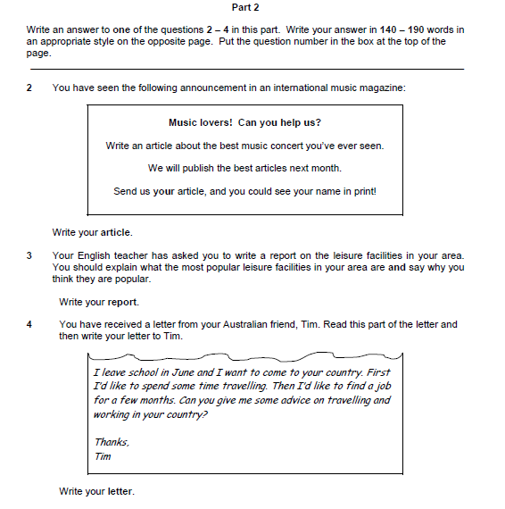
Notes:
Here, as you can see, candidates can decide to write an article, a report or an informal letter to a friend. You’ll see again that the word count has increased and is now 140 to 190 words.

Slide 16
Part 2 questions
What is the situation?
What are you writing about?
Why are you writing?
Who is going to read it?

Slide 17
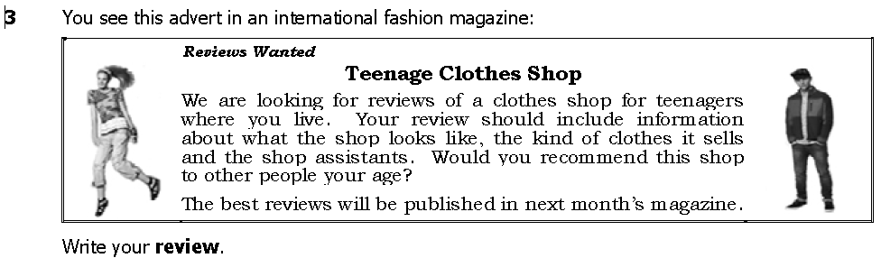
Part 2 task
context
topic
target reader
purpose

Slide 18
SPEAKING

Slide 19
The thrill of speaking is …
... the ability to express ourselves and
communicate our ideas, opinions and
emotions clearly.

Slide 20
CEFR B2 Speaking descriptors
CAN keep up a conversation on a fairly wide range of topics
CAN ask for clarification and further explanation
CAN express own opinion and present arguments to a limited extent
CAN answer predictable or factual questions.

Slide 21
Speaking paper overview
Part | Task type and format | Timing
1 | Conversation between interlocutor and each candidate (spoken questions). | 2 minutes
2 | Individual ‘long turn’ by each candidate with a short response from the second candidate. | 4 minutes total (1 minute turn; 30 seconds to respond)
3 | Two-way conversation between the candidates based on spoken instructions and written stimuli. Discussion and decision-making tasks. | 4 minutes total (2 minutes discussion; 1 minute decision-making)
4 | Discussion on topics related to Part 3. | 4 minutes
 | Overall timing: | 14 minutes

Slide 22
Assessment criteria
Grammar and Vocabulary
Discourse Management
Pronunciation
Interactive Communication
Global Achievement
control, range, appropriacy
extent, relevance, coherence, cohesion
intonation, stress, individual sounds
initiating, responding, development
overall effectiveness

Slide 23
Part 2
Task requirements
one candidate talks individually about a pair of pictures for one minute
the listening candidate comments briefly on the pictures
Testing focus
organising a larger unit of discourse
comparing
describing
expressing opinions

Slide 24
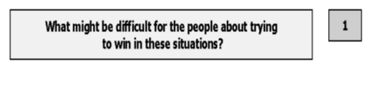
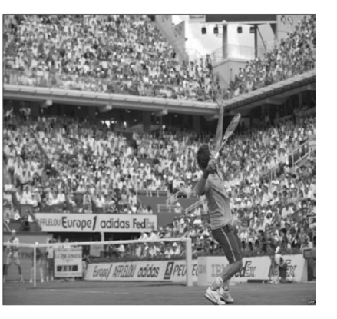

Part 2: sample task

Slide 25
Part 3 focus
sustaining an interaction
exchanging ideas
expressing and justifying opinions
comparing
agreeing and/or disagreeing
suggesting
speculating
evaluating
reaching a decision through negotiation

Slide 26
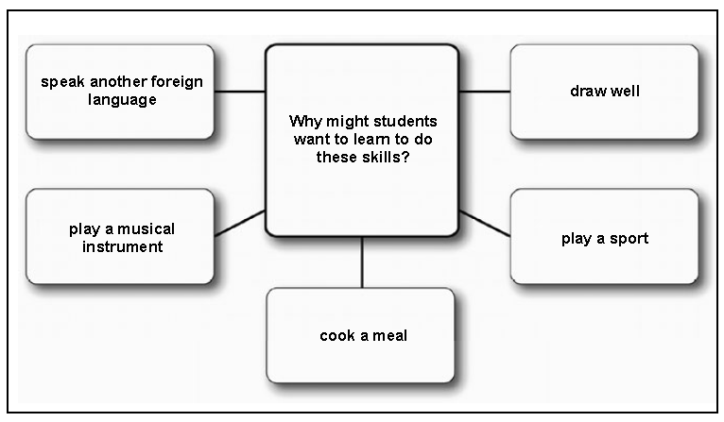
Part 3: sample task (2min.+1min.)
Part 3

Slide 27
Part 3 (1 min.)
Now you have about a minute to decide which two would be the easiest to learn to do well?

Slide 28
Cambridge English: First for Schools (FCE)
Kok Wee Chris
Grammar and Vocabulary 5 3
Discourse Management 5 3
Pronunciation 4 3
Interactive Communication 4 3
Global Achievement 4 3

Slide 29
Good candidates, Speaking FCE
Listen carefully and react
Show their interest
Interact
Move the conversation forward
Use eye contact
Body language to encourage partner

Slide 30
Good candidates, Speaking FCE (2)
Resourceful in their use of language (Part 2)
Find a way of expressing themselves (paraphrasing) (Part 2)
Balance fluency and accuracy
Help their partner

Slide 31
Good candidates, Speaking FCE (3)
- Can overcome nerves
Can maintain the flow for a full time ( know how long a minute is)
Know they have to extend some answers and know how to do it
Are not put off when examiner interrupts

Slide 32

Support for teachers
Teacher Support Website
www.teachers.Cambridgeenglish.org
  Free resources – lesson plans, handbooks, etc.
  Exam discussion forums
  Teacher tips
Publications for exam preparation
  Past Paper Packs
  Speaking Test Preparation Packs
  Top Tips Series for candidates
Notes:
32
Teacher website
Point out that the new Cambridge ESOL Teaching website
(www.teachers.CambridgeESOL.org) provides a user-friendly tool for all
teachers preparing students for Cambridge ESOL exams. Key features include:
an interactive file-sharing area which allows users to:
download materials (including lesson plans) created by both
Cambridge ESOL and teachers, handbooks, journals and exam reports
rate and comment on other people’s materials
upload their own teaching materials.
a new ‘Advice for Teachers’ section offering teaching tips and strategies
for every paper of each exam
moderated discussion forums for each exam
links to publishers and published materials for each exam
access to a handbook for each exam, sample papers, exam reports, and
further information on our teaching awards.
an events area that allows users to search for events according to
location and exam
Publications
Cambridge ESOL has expanded the number of publications it offers teachers
and candidates. Current launches include a range of Past Paper Packs and
Top Tips for IELTS Academic and Top Tips for IELTS General Training.

Slide 33
THANK YOU!
Irina Solokova

